Slide 1
Analysis of User Power Consumption
Elizabeth James
Sachin George
Vanessa Almond
Shivom Vishwakarma

Slide 2
Contents
Introduction
Proposed System
Implementation
Conclusion

Slide 3
Introduction
Energy consumption has been steadily increasing over the last few years
The project targets customer segments for specific energy efficiency recommendations, predict energy consumption as well as identify irregularities and outliers.

Slide 4
Introduction
There are 2 modules in the project.
Consumer oriented meter data analytical model
Predictive model using historical data

Slide 5
Proposed System
Consumer Oriented Meter Data Analytical Model
Group similar users based on the extracted features ie appliances
Analyse electricity consumption of various consumers within their respective groups
Generate consumption profiles to determine their usage patterns
Provide suggestions and recommendations for efficient energy usage.

Slide 6
Proposed System
Predictive Model using Historical Data
Study the behavior of the consumer’s power consumption trend based on historical data
Predict the energy usage
Identify irregularities and outliers

Slide 7
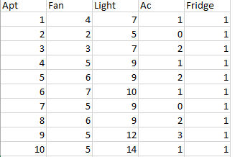
Implementation
Consumer Oriented Meter Data Analyical Model
Appliances Dataset of 200 households

Slide 8
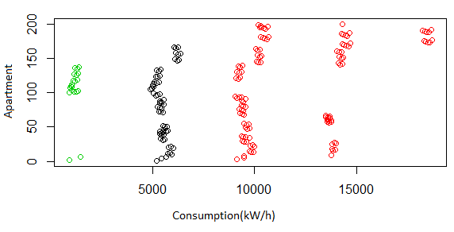
Implementation
Groups formed based on number and type of appliances

Slide 9
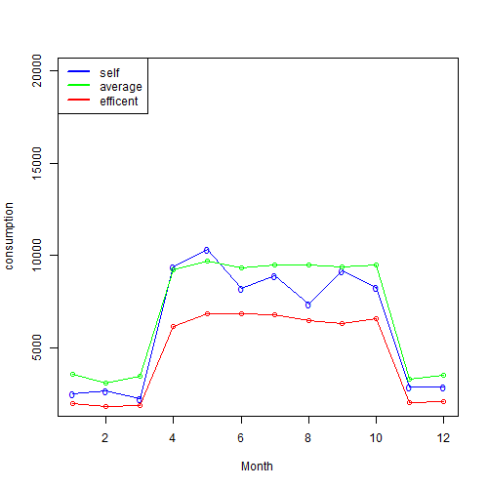
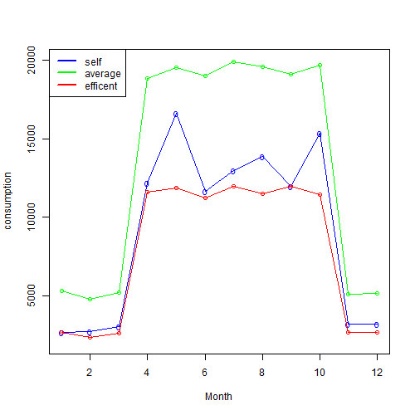
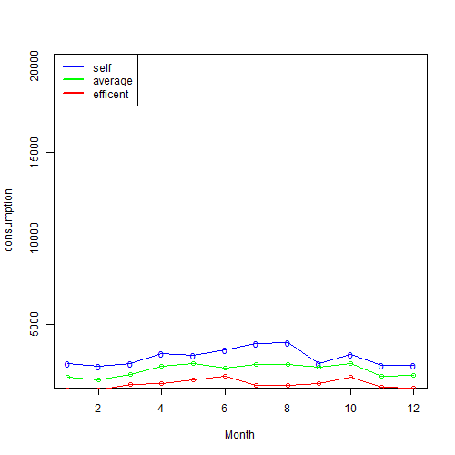
Implementation
For each group analysis is done, average and efficient consumptions are compared with the users consumption

Slide 10
Conclusion
Consumers with similar type and number of appliances are grouped together and analysis is performed in their respective group in order to suggest recommendations for efficient consumption
The analysis aids in setting standards for efficient energy consumption and identifies the outliers and irregularities in the consumption patterns
The system also uses historical consumption data of the consumer to understand the behavioral patterns in the consumption of electricity to predict user consumption.

Slide 11
Conclusion
The data is analyzed for:
Making efficient energy buying decisions based on the usage patterns
Presenting efficient energy consumption by comparing users
Prediction of energy usage based on past consumption trends
Energy theft detection
Comparing and correcting meter service provider performance, and detect and reduce unbilled energy
Making more efficient maintenance decisions that help avoid catastrophic grid failures

